Slide 1
Linear Algebra
Lecture 43

Slide 2
Linear Algebra
Lecture 43

Slide 3
Segment VI
Orthogonality and
Least Squares

Slide 4
Inner Product
Spaces

Slide 5
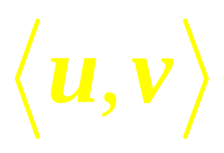
Definition
An inner product on a vector space V is a function that, to each pair of vectors u and v in V, associates a real number and satisfies the following axioms, for all u, v, w in V and all scalars c:
…

Slide 6
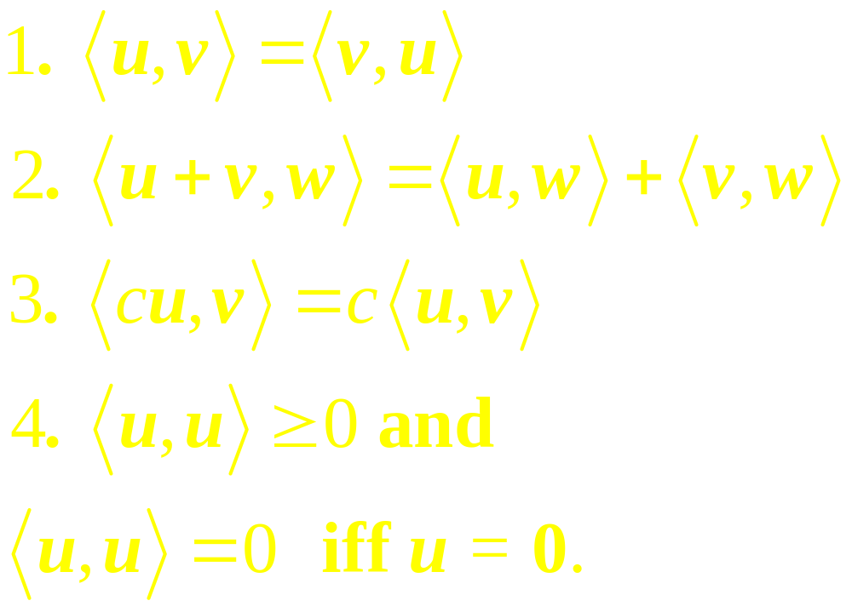
Continued
…

Slide 7
Continued
A vector space with an inner product is called an inner product space.

Slide 8
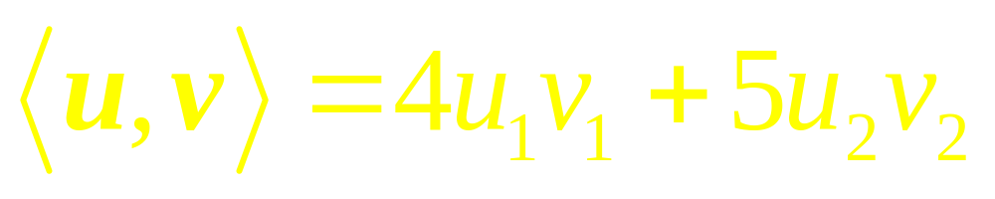
Example 1
Fix any two positive numbers-say, 4 and 5-and for vectors u= (u₁, u₂) and v = (v₁, v₂) in R², set
Show that it defines an inner product.

Slide 9
Example 2

Slide 10
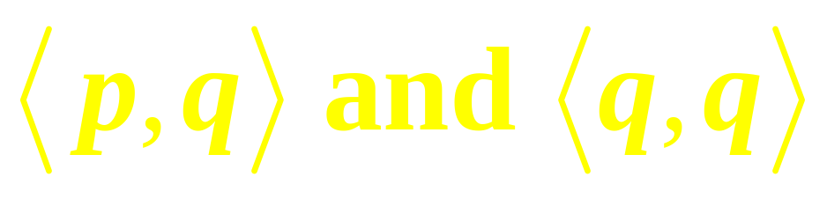
Example 3
Let V be P₂, with the inner product from Ex 2
where t₀ = 0, t₁ = 1/2, and t₂ = 1. Let p(t) = 12t² and q(t) = 2t – 1. Compute
…

Slide 11
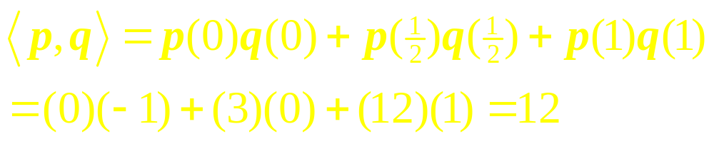
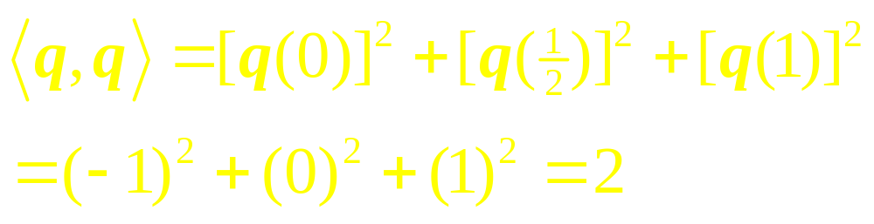
Solution

Slide 12
Lengths,
Distances and
Orthogonality
…

Slide 13
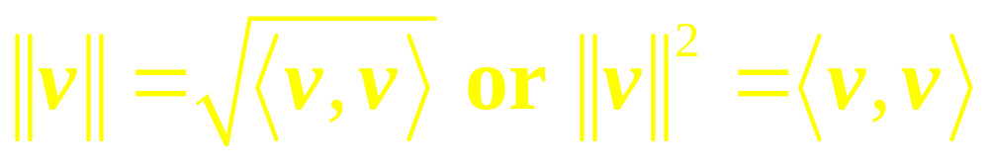
Let V be an inner product space, with the inner product denoted by . Just as in R^{n},
we define the length or norm of a vector v to be the scalar
…

Slide 14

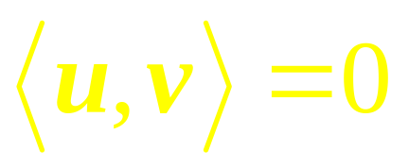
Continued
A unit vector is one whose length is 1.
The distance between u and v is .
Vectors u and v are orthogonal if .

Slide 15
Example 4
Compute the lengths of the vectors in Ex 3

Slide 16
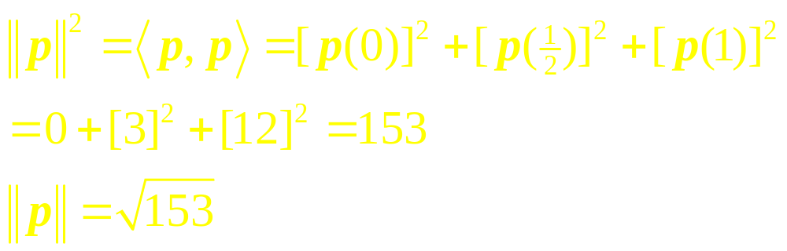
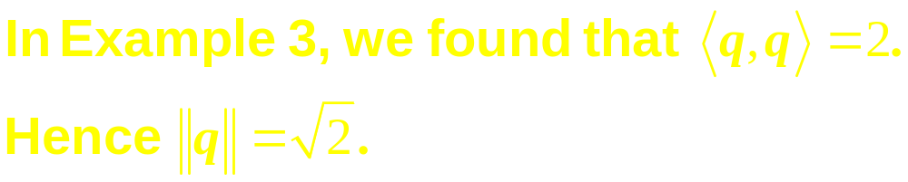
Solution

Slide 17
Example 5
Let V be P₄ with the inner product in Ex 2 involving evaluation of polynomials at –2, –1, 0, 1, and 2, and view P2 as a subspace of V.
…

Slide 18
Continued
Produce an orthogonal basis for P₂ by applying the Gram-Schmidt process to the polynomials 1, t, and t².

Slide 19
Best Approximation in
Inner Product Spaces

Slide 20
Example 6
Let V be P4 with the inner product in Ex 5 and let p₀, p₁, and p₂ be the orthogonal basis for the subspace P₂. Find the best approximation to p(t)=5-(1/2)t⁴ by polynomials in P₂.

Slide 21

Cauchy-Schwarz
Inequality

Slide 22

Triangle Inequality
…

Slide 23
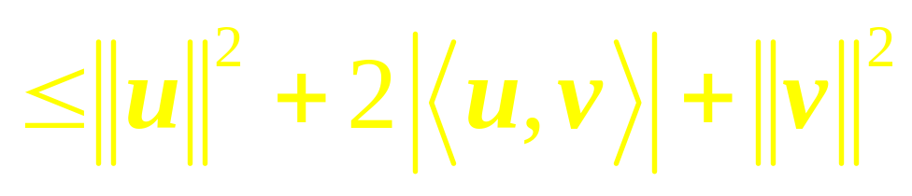


Proof

Slide 24
Inner-Product
for C[a,b]

Slide 25

Example 7
For f, g in C[a, b], set
Show that it defines an inner product on C[a, b].

Slide 26
Example 8
Let V be the space C[0, 1] with the inner product
…

Slide 27
Continued
Let W be the subspace spanned by the polynomials p₁(t) = 1, p₂(t) = 2t –1, and p₃(t) = 12t². Use the Gram-Schmidt process to find an orthogonal basis for W.

Slide 28
Linear Algebra
Lecture 43

